Slide 1
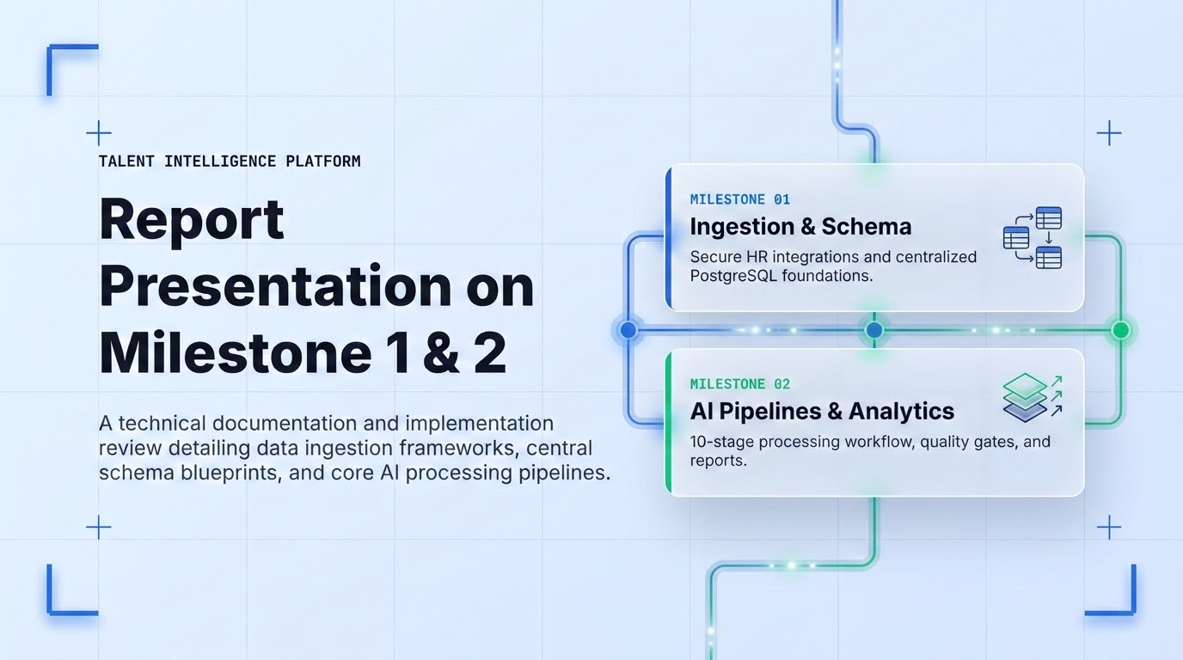

Slide 2
TALENT INTELLIGENCE ENGINE
Project Team Directory
Core professional mapping of research engineers, domain coordinators, and executive project implementation leads for Milestones 1 & 2.
CORE RESEARCH & QUALITY
G. Keertana, V. Sanjay Bhargav & Santhoshini
Data schema validation, pipeline governance, and ingestion audit.
AI SYSTEMS ENGINEERING
Navya, Swetha, Tanisha Gehlot & Kavya
Model pre-processing flow and core analytics workflow deployment.
INTEGRATION & INFRASTRUCTURE
Gowshika T, Lakshmikanth Reddy & Nikhil
Enterprise PostgreSQL schema architecture and cloud integrations.

Slide 3

AI Analysis Workflow & Processing Stages
A controlled 10-stage pipeline transforming raw workforce dataset inputs into validated HR decisions
Systematic Pipeline Index
Analytics Engine Architecture
01
Workforce Dataset: Approved records provided as primary input.
STAGE 01
Workforce Dataset
STAGE 02
Data Quality Gate
02
Data Quality Gate: Schema, variables, and identifiers checked.
03
Preprocessing: Data systematically cleaned and model-formatted.
04
Feature Engineering: Machine learning features prepared.
STAGE 03
Preprocessing
STAGE 04
Feature Engineering
05
Workforce Trends: Core workforce KPIs and trends generated.
06
Attrition Prediction: Model generates probability & risk profiles.
STAGE 05
Workforce Trends
STAGE 06
Attrition Prediction
07
Validation: Predictions audited against historical outcomes.
08
Health Analysis: Evaluation of satisfaction and stability markers.
09
Skill Gap: Integrated analysis of organizational requirements.
STAGE 07
07. Validation
STAGE 08
08. Health Analysis
STAGE 09
09. Skill Gap
10
Dashboard / Reports: Exposed business-readable analytics.
10. Dashboard & Strategic Reports (Access Layer)

Slide 4
Data Ingestion Layer & PostgreSQL Database Schema Foundations
Secure Enterprise HR Integrations & Relational Data Architecture
DATA INGESTION LAYER
The platform integrates workforce data from enterprise HR systems using secure connectivity mechanisms.
DATABASE SCHEMA: CENTRAL POSTGRESQL
The centralized PostgreSQL database schema stores workforce information using interconnected tables to maintain data integrity. Major database tables include:
SAP SuccessFactors Integration
The dashboard retrieves workforce information from SAP SuccessFactors using secure REST APIs with OAuth 2.0 authentication, ensuring all communication occurs over HTTPS with JSON data exchange.
TBL_01 Organization and Department
TBL_02 Employee and Job Position
TBL_03 Performance Review and Performance Goal
TBL_04 Attrition Record and Engagement Survey
TBL_05 Skills and Learning Records
TBL_06 Recruitment and Candidate
TBL_07 Data Source and Data Ingestion Log
TBL_08 Workforce Metrics and System User
Workday Enterprise Integration
The system also supports Workday integration using SOAP APIs, REST APIs, and Workday RaaS services with scheduled data extraction.

Slide 5
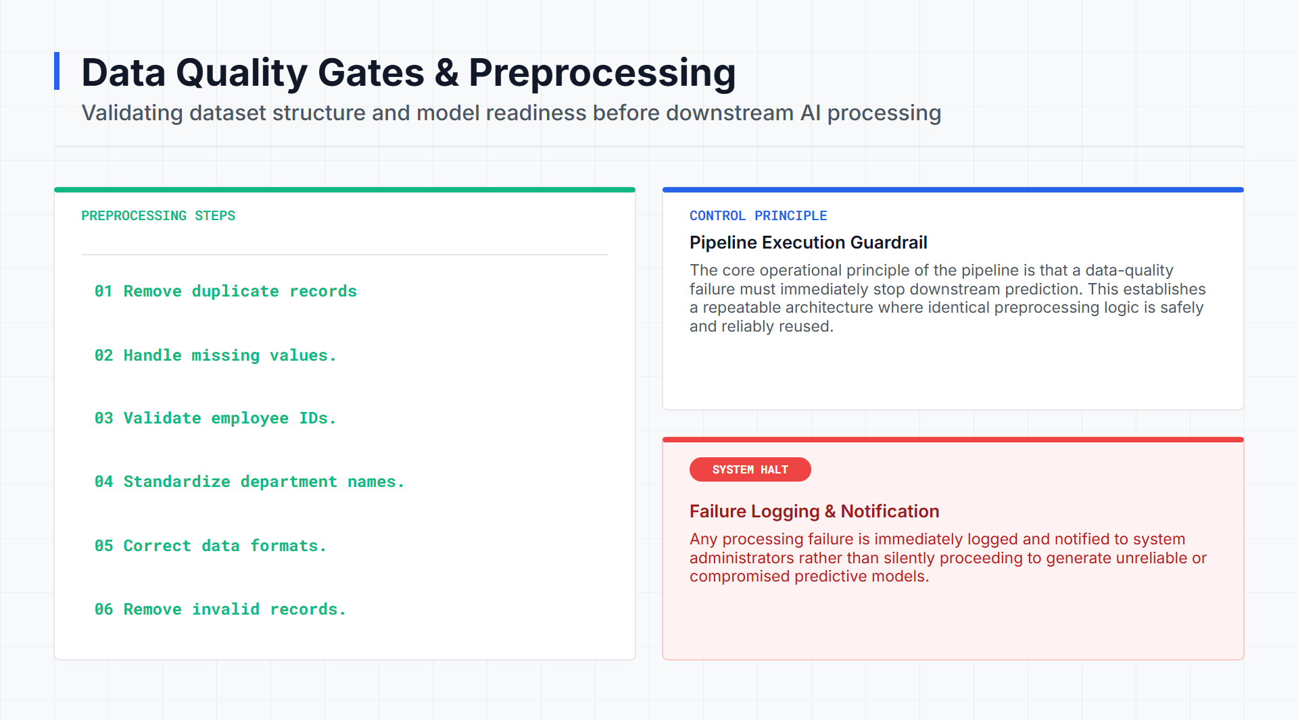

Slide 6

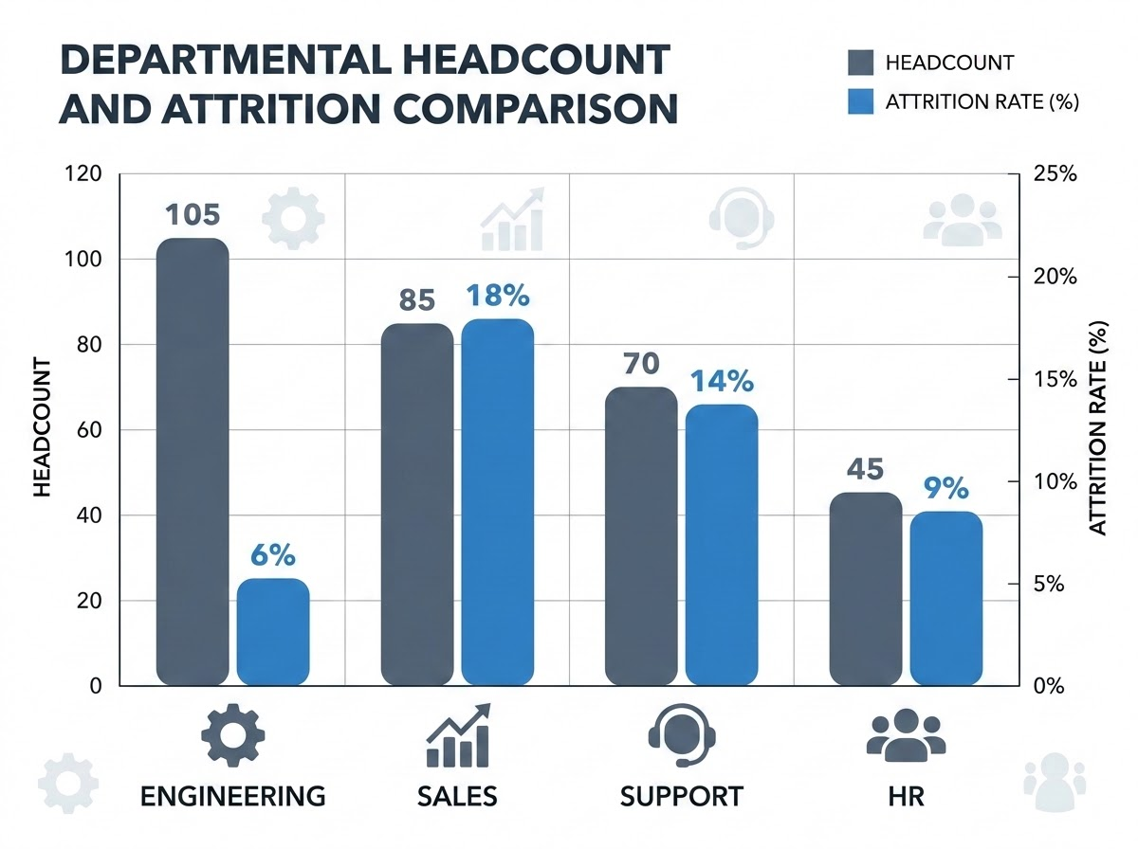
SYSTEM ARCHITECTURE
KPI Engine
Workforce Trend & KPI Monitoring
Automated monthly metrics calculation for real-time organizational health
PERIOD: AUG 2026
System Objectives
Our automated implementation extracts and monitors critical monthly workforce metrics to provide continuous, data-driven visibility into organizational vitality.
Key Capabilities
Continuous Monitoring
Instant calculation of core workforce metrics each cycle.
Granular Segments
Deep-dive comparisons across specialized departments.
Trend Analysis
Track historical trajectories to detect attrition risks early.
ACTIVE HEADCOUNT
305
ATTRITION RATE
11.6%
TURNOVER COUNT
35
AVERAGE TENURE
4.2 Yrs
AVG PERFORMANCE
87.4%
TRAINING / EMP
24.5 Hrs

Slide 7

Automated Anomaly Alerts & Attrition Threshold Monitoring
Configurable threshold-based monitoring system designed to proactively alert HR leadership
MONITORING SYSTEM CONCEPT
Baseline Threshold
5.0%
Configured Limit
Current Attrition
6.0%
Simulated Period
Proactive Trend Detection
The system features a highly configurable threshold-based monitoring system designed to proactively alert HR leadership to concerning workforce trends.
This mechanism converts a standard KPI into a reviewable alert, completely eliminating the need for manual inspection during every reporting period.
VALIDATION PASSED Verified via automated pipeline tests
CRITICAL
RULE_BREACH: ATTR_GT_THRESHOLD
Threshold Breach Detected
The system recorded an actual attrition rate of 6.0%, which exceeded the configured organizational baseline threshold of 5.0%. The automated alert successfully flagged the anomaly.
RULE_PARAM : ACTUAL (6.0%) > THRESHOLD (5.0%)
SYS_ACTION : CRITICAL_ALERT_DISPATCH
TEST_STATE : SUCCESSFUL_PIPELINE_VALIDATION

Slide 8
Attrition Prediction: Random Forest Model Configuration
model_config.yaml
MODEL METHODOLOGY
The predictive analytics engine utilizes a machine learning approach to identify employees with elevated attrition risk, providing an analytical input for HR review and workforce planning.
The implementation uses the historical Attrition field as the target, converting Yes/No responses into a binary format.
PRIMARY MODEL OUTPUTS
Predicted Class
The binary prediction of whether an employee will leave.
Attrition Probability
The statistical model probability associated with the predicted risk.
Risk Category
A business-readable translation categorizing employee risk (Low, Medium, High).
# Attrition Prediction Model Config
model_type: "Random Forest Classifier"
hyperparameters:
n_estimators: 100
class_weight: "balanced"
random_state: 42
dataset_split:
train_ratio: 0.80
test_ratio: 0.20
stratified: true
target_variable: "Attrition"

Slide 9

CRITICAL AUDIT
Attrition Model Performance & Historical Validation Metrics
Validation Findings
The reported 83.67% accuracy should not be treated as sufficient evidence of a highly reliable attrition model.
The notably low recall (8.51%) and F1-score (14.29%) indicate that the model currently misses many actual attrition cases.
The documentation explicitly identifies that further tuning and validation are necessary before the model can be used for autonomous production HR decisions.
The validation task audits prediction performance against historical workforce outcomes using 1,470 employee records and 34 columns. The Random Forest model's predictions were compared with actual historical outcomes to generate performance metrics.
ACCURACY
83.67%
High baseline prediction rate
PRECISION
44.44%
Moderate false positive rate
RECALL
8.51%
Critical Underperformance
F1 SCORE
14.29%
Severe class imbalance gap

Slide 10
Confusion Matrix & Employee-Level Validation Framework
Structured validation auditing and predictive quality control metrics
The validation workflow generates a comprehensive confusion matrix and detailed employee-level prediction information. The confusion matrix separates correct and incorrect prediction types (True Negative, False Positive, False Negative, True Positive) to help analysts understand exactly where the model succeeds and fails.
EMPLOYEE-LEVEL VALIDATION FIELDS (EXCEL)
Employee ID — The unique identifier for the workforce record.
Actual Attrition — The historical truth of whether the employee left.
PREDICTED NEGATIVE
PREDICTED POSITIVE
True Negative (TN)
Correct Prediction
Active Employee
False Positive (FP)
Incorrect Prediction
False Alarm
Predicted Attrition — The binary output generated by the model.
ACTUAL NEGATIVE
Attrition Probability — The statistical confidence of the prediction.
False Negative (FN)
Incorrect Prediction
Missed Attrition
True Positive (TP)
Correct Prediction
Attrition Flagged
ACTUAL POSITIVE
Prediction Correct — A boolean flag indicating if the prediction matched reality.
Risk Category — The assigned Low/Medium/High business classification.
These validation results, alongside feature importance and model metrics, form a complete audit trail for the predictive engine.

Slide 11
Feature Importance
Model-Derived Predictive Contributions
The Random Forest workflow generates feature-importance metrics to help explain which available workforce variables contribute most strongly to the model's predictions. This provides transparency into the AI's decision-making process.
Predictive Feature Importance Weights
Monthly Income
0.24
OverTime
0.18
Age
0.15
Important Distinction
These variables represent model-derived predictive features based on the provided dataset. They highlight mathematical contributions to the model's output and should not automatically be described as proven causal reasons for employee attrition.
They are indicators of risk, not necessarily the root causes.
Total Working Years
0.13
Distance From Home
0.11
Daily Rate
0.08
Monthly Rate
0.06
Years With Manager
0.05

Slide 12
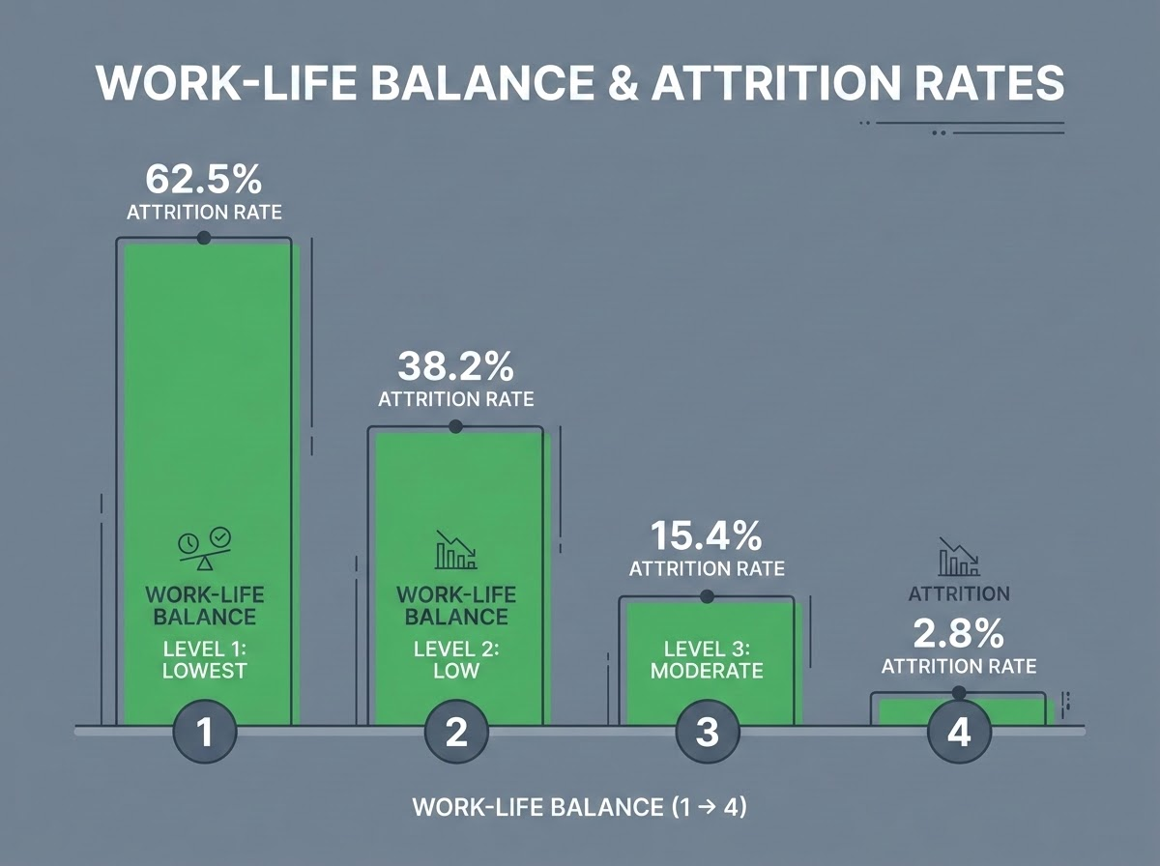
Workforce Health Score Validation
Evaluating historical attrition rates against work-life satisfaction levels
EVALUATION OVERVIEW
This report evaluates Job, Environment, and Relationship Satisfaction, alongside Work-Life Balance, against historical attrition outcomes.
WORK-LIFE LIKERT METRICS
Score 1 (Bad): 62.5% historical attrition rate
Score 2 (Good): 16.0% historical attrition rate
Score 3 (Better): 5.7% historical attrition rate
Score 4 (Best): 2.8% historical attrition rate
VALIDATION CAUTION
Statistical Association Only
Results show a statistical association. They must be interpreted with caution and should not be presented as universal HR rules or as definitive proof of causation.
Figure 1: Attrition rates decrease exponentially as Work-Life Balance scores improve from Level 1 (Lowest) to Level 4 (Highest).

Slide 13
Skill Gap Analysis Model Proposals & Dataset Limitations
PROPOSED MODEL DESIGN
The proposed skill-gap analysis utilizes a Random Forest classification workflow to identify training opportunities.
Inputs: JobRole, ExistingSkills, RequiredSkills
Target: GapStatus
DATASET LIMITATION
IBM HR Analytics Dataset Constraint
The current IBM HR Analytics Employee Attrition dataset does not contain an employee skills inventory or a role-to-skill taxonomy.
Therefore, actual employee-level skill-gap prediction cannot be executed or claimed from this dataset alone.
The module requires a separate skills dataset or a defined role-to-skill mapping to function.
REQUIRED SKILL-GAP PROCESS FLOW
01
Collect employee/job-role information.
02
Identify existing skills.
03
Identify required role skills.
04
Compare existing vs required skills.
05
Identify missing skills / gap status.
06
Generate training or upskilling area.
07
Validate and expose the result.

Slide 14
System Automation, Exception Controls & Integration Gates
The workflow architecture defines strict triggers and exception-handling matrices to ensure that unreliable analytical outputs are never silently published to the business dashboard.
SYSTEM TRIGGERS
EXCEPTION-HANDLING MATRIX
TRIG_01 // INGESTION
New or updated datasets
PIPELINE CONDITION
SYSTEM RECOVERY ACTION
Data-Quality Failure
Stops downstream processing immediately, logs the error, notifies administrators, and retains the last validated output.
TRIG_02 // TEMPORAL
Scheduled data refreshes
Model-Validation Failure
Holds prediction publication, logs the failure, and retains the last validated output.
TRIG_03 // ANOMALY
Risk threshold breaches
Successful Validation
Publishes updated predictions and dashboard-ready outputs.
TRIG_04 // LIFECYCLE
Model retraining events
Threshold Breach
Generates an automated alert for HR review.

Slide 15

Implementation Checklist & Dashboard Integration Roadmap
To finalize the Milestone 2 integration, the following 12-point checklist ensures all data gates, models, and validation metrics are correctly connected to the final dashboard:
PHASE 1: DATA & MODEL INTEGRATION
PHASE 2: QUALITY & VALIDATION GATES
01 Confirm the common input dataset and data-quality gate.
07 Connect health-score analysis and documented recommendations.
02 Connect workforce trend-monitoring output to the dashboard layer.
08 Keep the skill-gap module clearly marked as requiring skills data.
03 Connect attrition model prediction and probability outputs.
09Apply threshold and alert logic.
04 Connect validation metrics and confusion matrix.
10 Ensure validation failure does not publish unvalidated predictions.
05 Connect employee-level validation results.
11 Prepare final dashboard-ready outputs.
06 connect feature-importance results.
12 Prepare documentation and presentation evidence.

Slide 16
